Slide 1
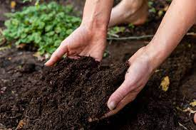
SOIL
Prepared By : Ms. Jaanya Jaison
Class : 4 A

Slide 2
CONTENTS
What is Soil
Importance of soil
Layers of Soil
Types of soil
What is Soil Erosion

Slide 3
What is soil?

Slide 4
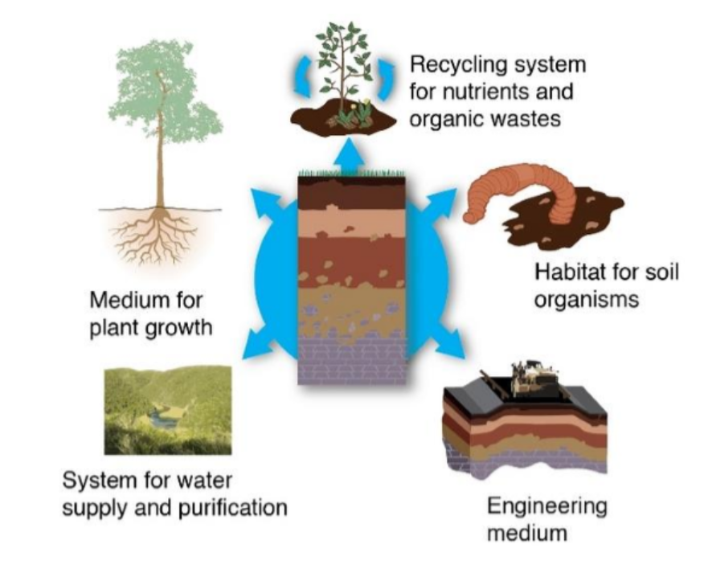
Importance of Soil

Slide 6
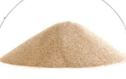
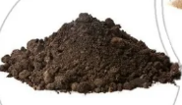
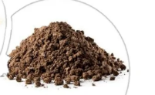

Slide 7
What is Soil Erosion?

